Slide 1
Tsunamisimulation
SWE
Alex, Ludwig

Slide 2
1 Bathymetry
Adjustment of the Flux-Function by adding the Bathymetrie-Term
Adding the reflecting boundary conditions

Slide 3
1 Bathymetry

Slide 4
2 Hydraulic jumps
Subcritical flow
  At position 10:
  Maximum froude number 0.584358
Supercritical flow
  At position 10:
  Maximum froude number 1.22609

Slide 5
2 Hydraulic jumps

Slide 6
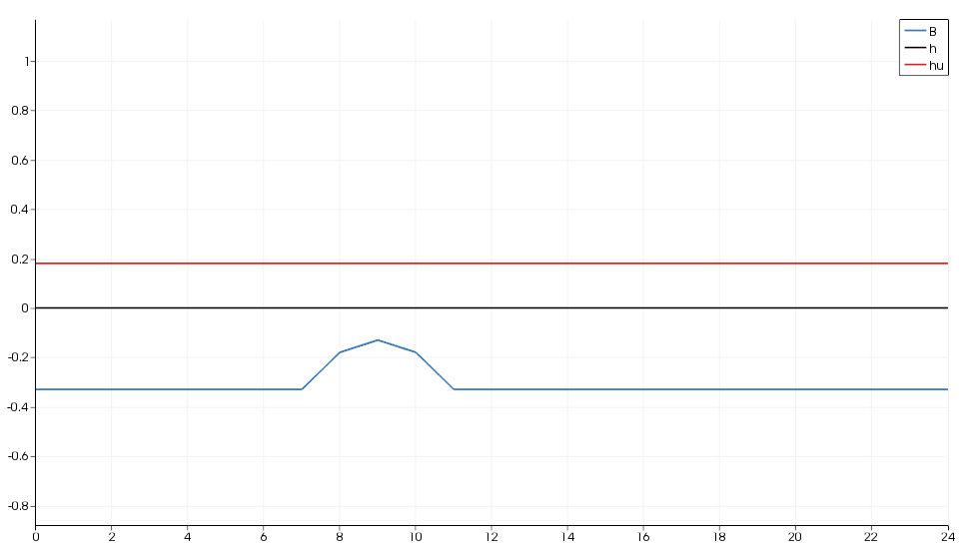
2 Hydraulic jumps

Slide 7
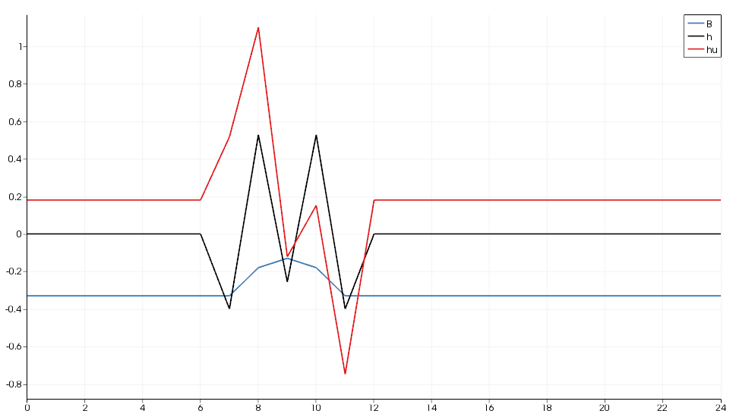
2 Hydraulic jumps

Slide 8
3 Dimensional splitting
Compute horizontal updates first
Set temporary h and hu
Compute vertical updates with temporary h and hu
Set new h and hu

Slide 9
3 Dimensional splitting

Slide 10
3 Dimensional splitting

